Slide 1
NETWORK DEVICES

Slide 2
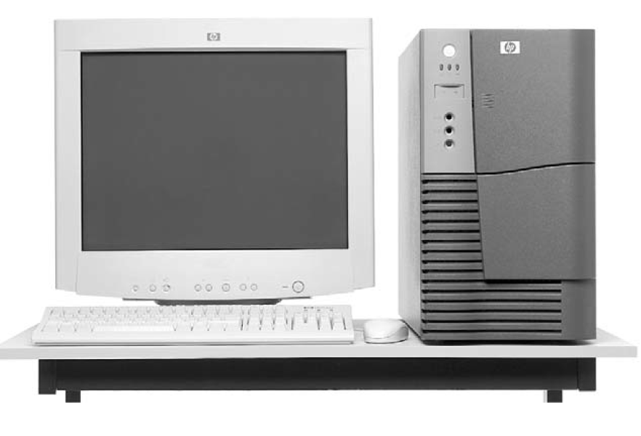
NETWORKING DEVICES
Equipment that connects directly to a network segment is called a device.
These devices are broken into two classifications:
End user devices—Include computers, printers, scanners, and other devices that provide services directly to the user.
Network devices—Include all devices that connect the end-user devices to allow them to communicate.
End-user devices that provide users with a connection to the network are also called hosts.
End-User Device: Workstation
There are no standardized symbols for end-user devices in the networking industry.
They bear a resemblance to the real device to allow for quick recognition.
Network devices provide transport for the data that needs to be transferred between end-user devices.
Network devices extend cable connections, concentrate connections, convert data formats, and manage data transfers.
Examples of devices that perform these functions are repeaters, hubs, bridges, switches, and routers.

Slide 3
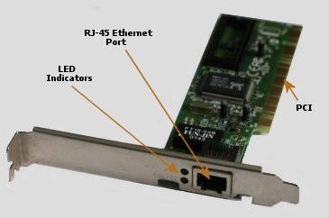
NETWORK INTERFACE CARD (NIC)
Host devices are physically connected to the network media using a Network Interface Card (NIC).
A NIC is a printed circuit board that fits into the expansion slot of a bus on a computer motherboard, or it can be a peripheral device.
It is also called a network adapter.
Network interface cards (NICs) are considered Layer 2 devices because each NIC throughout the world carries a unique code, called a Media Access Control (MAC) address.
This address controls data communication for the host on the LAN. The NIC controls the access of the host to the medium.
Peripheral Component Interconnect (PCI) is a local computer bus for attaching hardware devices in a computer and is part of the PCI Local Bus standard

Slide 4
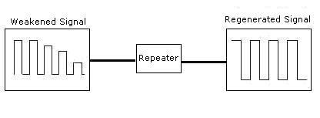
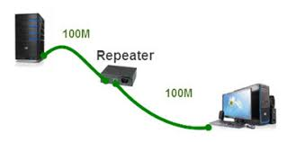
REPEATERS
Repeaters are networking devices that exist at Layer 1, the physical layer, of the OSI reference model.
As data leaves a source and goes out over the network, it is transformed into either electrical or light pulses that pass along the networking medium.
These pulses are called signals. When signals leave a transmitting station, they are clean and easily recognizable.
However, the longer the cable length, the weaker and more deteriorated the signals become as they pass along the networking medium.
The purpose of a repeater is to regenerate and retime network signals at the bit level, allowing them to travel a longer distance on the medium.
The term repeater originally meant a single port “in” device and a single port “out”
device.
Today multiple-port repeaters also exist. Repeaters are classified as Layer 1 devices in the OSI model because they act only on the bit level and look at no other information.

Slide 5
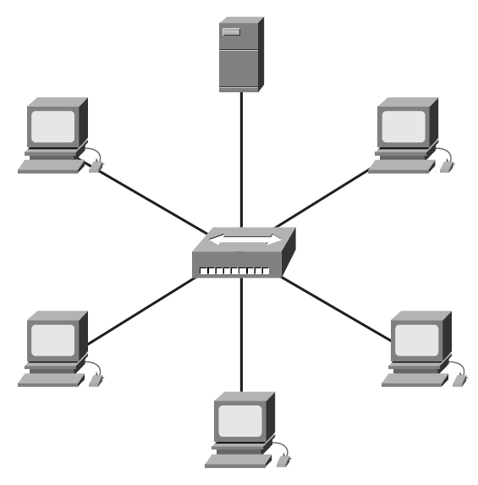
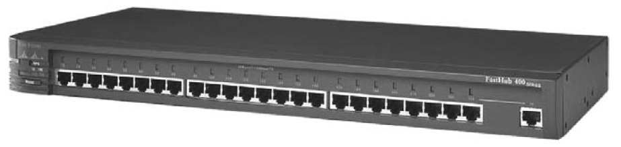
HUBS
The purpose of a hub is to regenerate and retime network signals.
The characteristics of a hub are similar to those of a repeater.
A hub is a common connection point for devices in a network.
Hubs commonly connect segments of a LAN.
A hub contains multiple ports.
When a packet arrives at one port, it is copied to the other ports so that all the LAN’s segments can see all the packets.
Because hubs and repeaters have similar characteristics, a hub is also called a multiport repeater.
The difference between a repeater and a hub is the number of cables that connect to the device.
Whereas a repeater typically has only two ports, a hub generally has from four to 20 or more ports.
Whereas a repeater receives on one port and repeats on the other, a hub receives on one port and transmits on all the other ports.
Important properties of hubs:
Hubs amplify signals.
Hubs propagate signals through the network.
Hubs do not require filtering.
Hubs do not require path determination or switching.
Hubs are used as network-concentration points.

Slide 6
HUBS
Hubs are commonly used in Ethernet 10BASE-T or 100BASE-T networks.
Hubs create a central connection point for the wiring medium.
They also increase the network’s reliability by allowing any single cable to fail without disrupting the entire network.
This feature differs from the bus topology, in which the failure of one cable disrupts the entire network.
Hubs are considered Layer 1 devices because they only regenerate the signal and repeat it out all their ports (network connections).
The function of Layer 1 devices is simply to facilitate the transmission of signals.
The devices recognize no information patterns in the signals, no addresses, and no data. When two wires are connected using hubs or repeaters, all the interconnections are part of a collision domain.
In Ethernet networks, all the hosts are connected to the same physical medium.
Signals that are sent out across the common medium are received by all devices.
A collision is a situation that can occur when 2 bits propagate at the same time on the same network.
The area within the network from where the data packets originate and collide is called a collision domain.
All shared-media environments are collision domains, or bandwidth domains.
In its most basic form, a hub does nothing except provide a pathway for the electrical signals to travel along.
Such a device is called a passive hub.
Far more common nowadays is an active hub, which, as well as providing a path for the data signals, regenerates the signal before it forwards it to all of the connected devices. A hub does not perform any processing on the data that it forwards, nor does it perform any error checking.

Slide 7
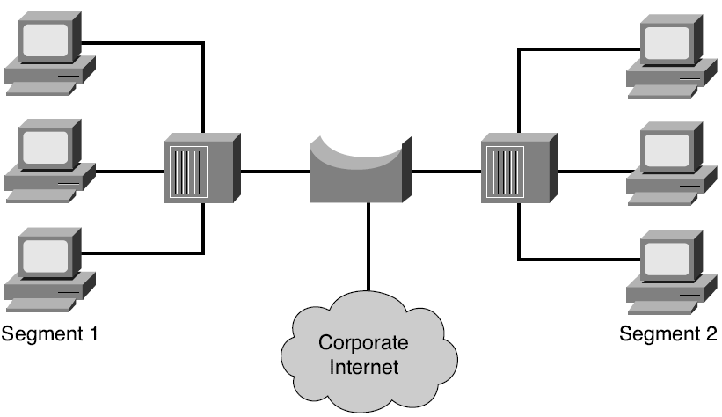
BRIDGES
Bridge is a Layer 2 device designed to create two or more LAN segments, each of which is a separate collision domain.
In other words, bridges were designed to create more usable bandwidth.
The purpose of a bridge is to filter traffic on a LAN to keep local traffic local yet allow connectivity to other parts (segments) of the LAN for traffic that is directed there.
Every networking device has a unique MAC address on the NIC.
The bridge keeps track of which MAC addresses are on each side of the bridge and makes forwarding decisions based on this MAC address list.
Bridges filter network traffic by looking only at the MAC address.
Therefore, they can rapidly forward traffic representing any network layer protocol.
Because bridges look only at MAC addresses, they are not concerned with network layer protocols.
Consequently, bridges are concerned only with passing or not passing frames, based on their destination MAC addresses.
The following are the important properties of bridges:
Bridges are more “intelligent” than hubs.
That is, they can analyze incoming
frames and forward (or drop) them based on addressing information.
Bridges collect and pass packets between two or more LAN segments.
Bridges create more collision domains, allowing more than one device to transmit simultaneously without causing a collision.
Bridges maintain MAC address tables.

Slide 8
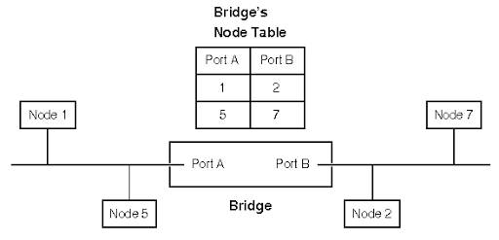
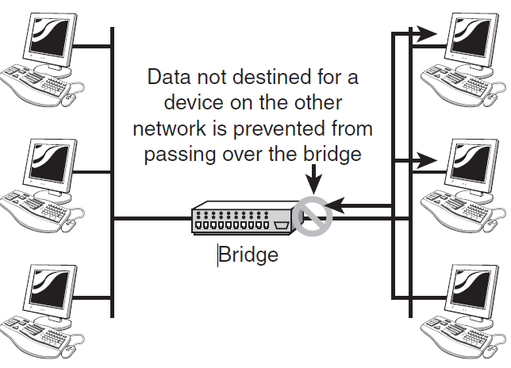
BRIDGES
What defines a bridge is its Layer 2 filtering of frames.
To filter or selectively deliver network traffic, bridges build tables of all MAC addresses located on a network segment and other networks and then map them to associated ports.
The process is as follows:
Step 1 If data comes along the network medium, a bridge compares the destination
MAC address carried by the data to MAC addresses contained in its tables.
Step 2 If the bridge determines that the data’s destination MAC address is from the same network segment as the source, it does not forward the data to other segments of the network. This process is known as filtering. By performing this process, bridges can significantly reduce the amount of traffic between network segments by eliminating unnecessary traffic.
Step 3 If the bridge determines that the data’s destination MAC address is not from the same network segment as the source, it forwards the data to the appropriate segment.
Step 4 If the destination MAC address is unknown to the bridge, the bridge broadcasts the data to all devices on a network except the one on which it was received. This process is known as flooding.
A broadcast is a data packet that is sent to all nodes on a network.
A broadcast domain consists of all the devices connected to a network that receive the data packet broadcast by a node to all other nodes on the same network.
Because every device on the network must pay attention to broadcasts, bridges always forward them. Therefore, all segments in a bridged environment are considered to be in the same broadcast domain.
As was the case in the repeater/hub combination, another device, called a switch, is used for multiple bridge connections.

Slide 9
BRIDGES
Three types of bridges are used in networks:
➤ Transparent bridge—Derives its name from the fact that the devices on the network are unaware of its existence.
A transparent bridge does nothing except block or forward data based on the MAC address.
➤ Source route bridge—Used in Token Ring networks.
The source route bridge derives its name from the fact that the entire path that the packet is to take through the network is embedded within the packet.
➤ Translational bridge—Used to convert one networking data format to another; for example, from Token Ring to Ethernet and vice versa.
Today, bridges are slowly but surely falling out of favour.
Ethernet switches offer similar functionality; they can provide logical divisions, or segments, in the network.
In fact, switches are sometimes referred to as multiport bridges because of the way they operate.

Slide 10
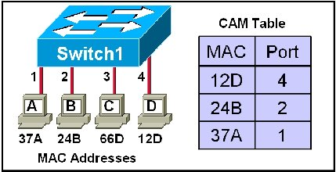
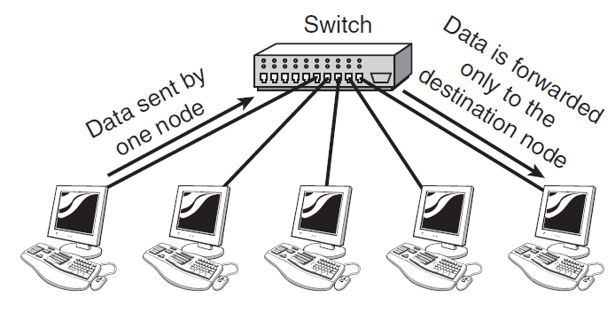
SWITCH
Like hubs, switches are the connectivity points of an Ethernet network.
The difference between hubs and switches is in how the devices deal with the data that they receive.
Whereas a hub forwards the data it receives to all of the ports on the device, a switch forwards it only to the port that connects to the destination device.
It does this by learning the MAC address of the devices attached to it, and then by matching the destination MAC address in the data it receives.
By forwarding data only to the connection that should receive it, the switch can improve network performance in two ways.
First, by creating a direct path between two devices and controlling their communication, it can greatly reduce the number of collisions on the network.
Collisions occur on Ethernet networks when two devices attempt to transmit at exactly the same time. In addition, the lack of collisions enables switches to communicate with devices in full-duplex mode.
In a full-duplex configuration, devices can send and receive data from the switch at the same time. Contrast this with half-duplex communication, in which communication can occur in only one direction at a time.
Full-duplex transmission speeds are double that of a standard, half-duplex, connection. So, a 10Mbps connection becomes 20Mbps, and a 100Mbps connection becomes 200Mbps.

Slide 11
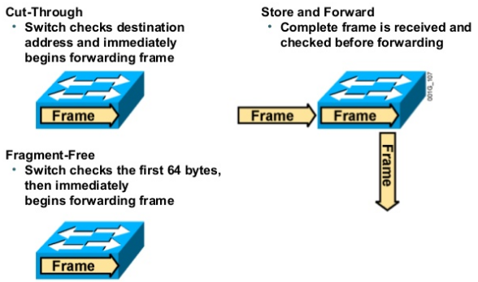
SWITCH
Irrespective of whether a connection is at full or half duplex, the method of switching dictates how the switch deals with the data it receives. The following is a brief explanation of each method:
➤ Cut-through—In a cut-through switching environment, the packet begins to be forwarded as soon as it is received.
This method is very fast, but creates the possibility of errors being propagated through the network, as there is no error checking.
➤ Store-and-forward—Unlike cut-through, in a store-and-forward switching environment, the entire packet is received and error checked before being forwarded.
The upside of this method is that errors are not propagated through the network.
The downside is that the error checking process takes a relatively long time, and store-and-forward switching is considerably slower as a result.
➤ Fragment Free—To take advantage of the error checking of store-and forward switching, but still offer performance levels nearing that of cut through switching, Fragment Free switching can be used.
In a Fragment Free-switching environment, enough of the packet is read so that the switch can determine whether the packet has been involved in a collision.
As soon as the collision status has been determined, the packet is forwarded.

Slide 12
LAYER 2 SWITCH:SUMMARY
Layer 2 switches, also called LAN switches or workgroup switches, often replace shared hubs.
Like bridges, switches connect LAN segments, use a table of MAC addresses to determine the segment on which a frame needs to be transmitted, and reduce traffic.
Switches operate at much higher speeds than bridges.
Switches are data link layer devices that, like bridges, let multiple physical LAN segments be interconnected into single larger networks.
Similar to bridges, switches forward and flood traffic based on MAC addresses.
Because switching is performed in hardware, it is significantly faster than the switching function performed by a bridge using software.
Think of each switch port as a micro bridge.
Each switch port acts as a separate bridge and gives each host the medium’s full bandwidth. This process is called micro segmentation.
Micro segmentation allows the creation of private or dedicated segments—one host per segment.
Each host receives instant access to the full bandwidth and does not have to compete for available bandwidth with other hosts.
In full-duplex switches, because only one device is connected to each switch port, collisions do not occur.
However, as with a bridge, a switch forwards a broadcast message to all the segments on the switch.
All segments in a switched environment are therefore considered to be in the same broadcast domain.
Some switches—mainly high-end and enterprise-level switches—perform multilayer functioning and it can perform some Layer 3 functions.

Slide 13
ROUTER
Routers are used to create larger networks by joining two network segments.
A router can be a dedicated hardware device or a computer system with more than one network interface and the appropriate routing software.
All modern network operating systems include the functionality to act as a router.
A router derives its name from the fact that it can route data it receives from one network onto another.
When a router receives a packet of data, it reads the header of the packet to determine the destination address.
Once it has determined the address, it looks in its routing table to determine whether it knows how to reach the destination and, if it does, it forwards the packet to the next hop on the route.
The next hop might be the final destination, or it might be another router.

Slide 14
STATIC ROUTING
In environments that use static routing, routes and route information are entered into the routing tables manually.
Not only can this be a time-consuming task, but also errors are more common. Additionally, when there is a change in the layout, or topology, of the network,. statically configured routers must be manually updated with the changes
Again, this is a time consuming and potentially error-laden task.
For these reasons, static routing is suited to only the smallest environments with perhaps just one or two routers.
A far more practical solution, particularly in larger environments, is to use dynamic routing.

Slide 15
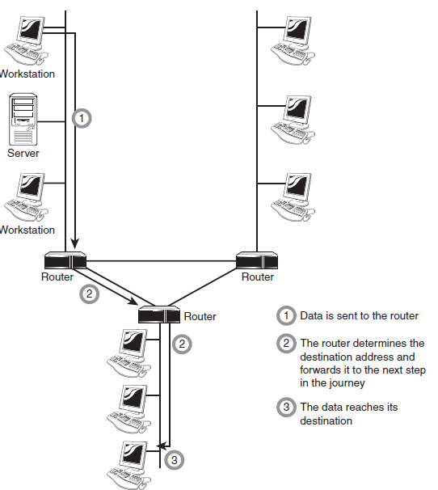
DYNAMIC ROUTING
Dynamic Routing
In a dynamic routing environment, routers use special routing protocols to communicate.
The purpose of these protocols is simple; they enable routers to pass on information about themselves to other routers so that other routers can build routing tables.
There are two types of routing protocols used—the older distance vector protocols and the newer link state protocols.

Slide 16
DISTANCE VECTOR ROUTING
The most commonly used distance vector routing protocols is called Routing Information Protocol (RIP).
It is used on networks running TCP/IP.
Distance vector routing protocols operate by having each router send updates about all the other routers it knows about to the routers directly connected to it.
These updates are used by the routers to compile their routing tables.
The updates are sent out automatically every 30 or 60 seconds.
The actual interval depends on the routing protocol being used.
Apart from the periodic updates, routers can also be configured to send a triggered update if a change in the network topology is detected. The process by which routers learn of a change in the network topology is known as convergence.

Slide 17
DISTANCE VECTOR PROTOCOLS: PROBLEMS
Although distance vector protocols are capable of maintaining routing tables, they have three problems.
The first is that the periodic update system can make the update process very slow.
The second problem is that the periodic updates can create large amounts of network traffic—much of the time unnecessarily as the topology of the network should rarely change.
The last, and perhaps more significant, problem is that because the routers only know about the next hop in the journey, incorrect information can be propagated between routers, creating routing loops.
Two strategies are used to combat this last problem. One, split horizon, works by preventing the router from advertising a route back to the other router from which it was learned.
The other, poison reverse (also called split horizon with poison reverse), dictates that the route is advertised back on the interface from which it was learned, but that it has a metric of 16.
Metric of 16 is considered an unreachable destination.

Slide 18
LINK STATE ROUTING
Link state routing works quite differently from distance vector-based routing.
Rather than each router telling each other connected router about the routes it is aware of, routers in a link state environment send out special packets, called link state advertisements (LSA), which contain information only about that router.
These LSAs are forwarded to all the routers on the network, which enables them to build a map of the entire network.
The advertisements are sent when the router is first brought onto the network and when a change in the topology is detected.
Of the two (distance vector and link state), distance vector routing is better suited to small networks and link state routing to larger ones.
Link state protocols do not suffer from the constant updates and limited hop count, and they are also quicker to correct themselves (to converge) when the network topology changes.
On TCP/IP networks, the most commonly used link state routing protocol is the Open Shortest Path First (OSPF).

Slide 19
GATEWAYS
CSU/DSU
CSU/DSU
A Channel Service Unit/Digital Service Unit (CSU/DSU), sometimes called Data Service Unit, is a device that converts the digital signal format used on LANs into one used on WANs.
Such translation is necessary because the networking technologies used on WANs are different from those used on LANs.
The CSU/DSU sits between the LAN and the access point provided by the telecommunications company.
Many router manufacturers are now incorporating CSU/DSU functionality into their products.
Gateways
Any device that translates one data format to another is called a gateway.
Some examples of gateways include a router that translates data from one network protocol to another, a bridge that converts between two networking systems, and a software application that converts between two dissimilar formats.
The key point about a gateway is that only the data format is translated, not the data itself.
In many cases, the gateway functionality is incorporated into another device.
The term default gateway refers to a router to which all network transmissions not destined for the local network are sent.

Slide 20
WIRELESS ACCESS POINTS
APs are typically a separate network device with a built-in antenna, transmitter, and adapter.
Wireless access points (APs) are a transmitter and receiver (transceiver) device used to create a wireless LAN (WLAN).
APs use the wireless infrastructure network mode to provide a connection point between WLANs and a wired Ethernet LAN.
APs also typically have several ports allowing a way to expand the network to support additional clients.
A wireless AP today can provide different services in addition to just an access point.
Many APs provide firewall capabilities and DHCP service.
When they are hooked up, they will provide client systems with a private IP address and then prevent Internet traffic from accessing client systems.
So in effect, the AP is a switch, a DHCP Server, router, and a firewall.
APs come in all different shapes and sizes.
Home or small office use APs have low powered antennas and limited expansion ports.
Higher end APs used for commercial purposes have very high powered antennas enabling them to extend the range that the wireless signal can travel.

Slide 21
MODEM
A modem, short for modulator/demodulator, is a device that converts the digital signals generated by a computer into analog signals that can travel over conventional phone lines.
The modem at the receiving end converts the signal back into a format the computer can understand.
Modems can be used as a means to connect to an ISP or as a mechanism for dialing up to a LAN.
Modems can be internal add-in expansion cards, external devices that connect to the serial or USB port of a system, PCMCIA cards designed for use in laptops, or proprietary devices designed for use on other devices such as portables and handhelds.
The configuration of a modem depends on whether it is an internal or external device.

Slide 22
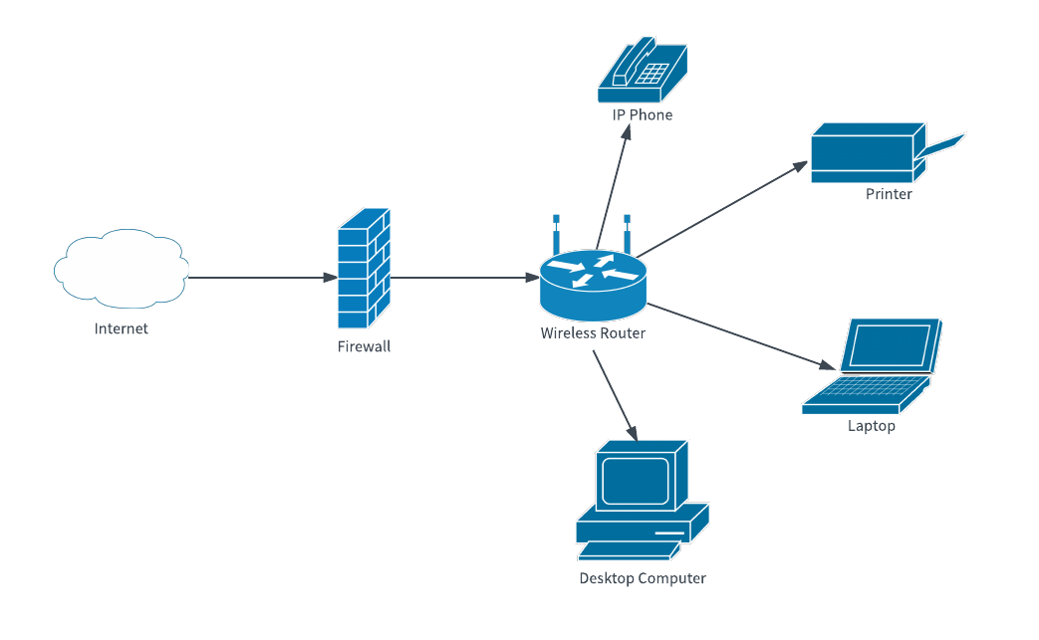
WIRELESS ROUTER IN NETWORK

Slide 23
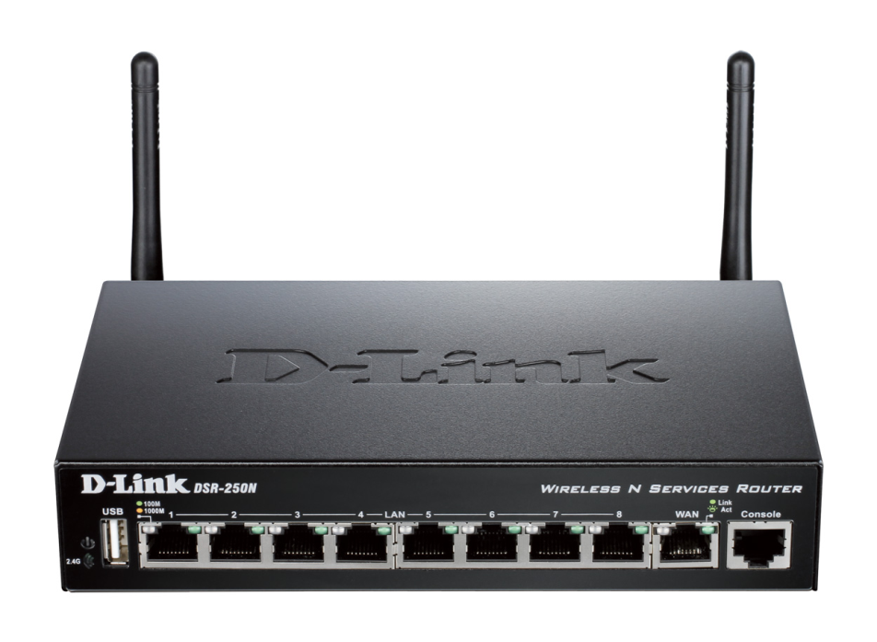
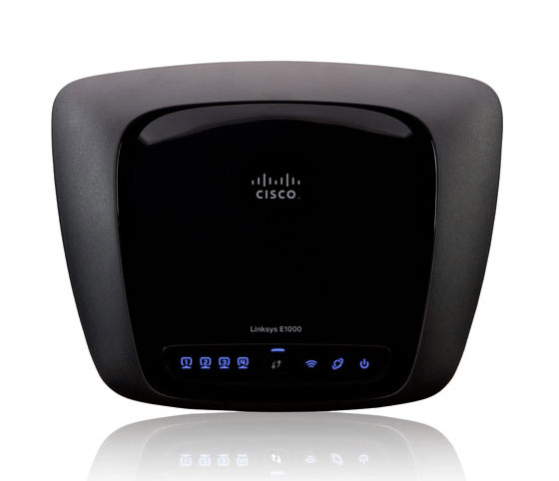
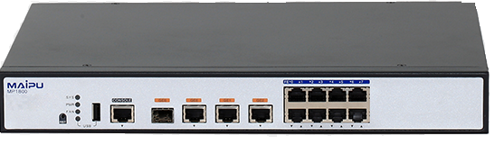
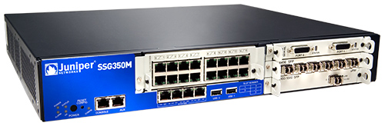
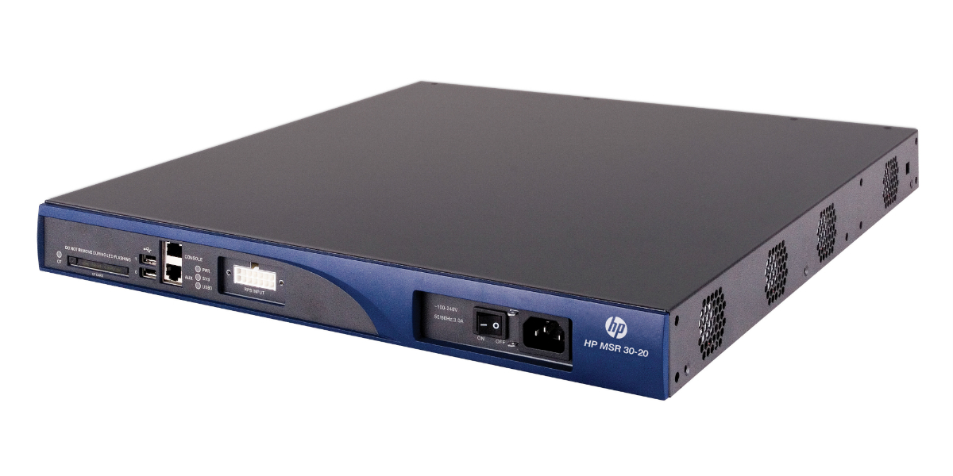

Slide 24
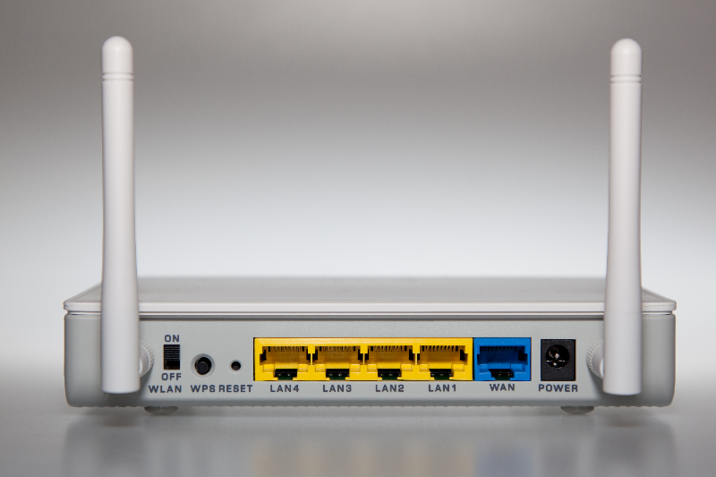

Slide 25
